Slide 1

Library Management System
Python and SQL databases
mini project

Slide 2



Introduction
Title: Library Management System
Brief overview of the project: The Library Management System is a software application designed to help libraries efficiently manage their resources, track book availability, and streamline lending processes.
Purpose: Efficiently manage library operations
Features: Search, Borrow, Return, Renew, Review, Events, Reservations, Fines, Authors, Reports

Slide 3

Project Architecture
Database: MySQL
Frontend: Python Tkinter
Backend: Python, MySQL Connector
Features Overview: Login, Main Window with Entity Buttons

Slide 4
Code Overview
Key functions:
Login: Validates user credentials against the database.
Search book: Searches for a book by title and displays availability.
Borrow book: Allows users to borrow available books.
Return book: Facilitates the return of borrowed books.
Renew book: Extends the loan period of a book for users.
Database interaction: Uses MySQL queries to interact with the database, such as selecting, inserting, updating, and deleting records.
Error handling and validation: Includes checks for invalid inputs, duplicate entries, and other potential errors to ensure data integrity and user experience.

Slide 5

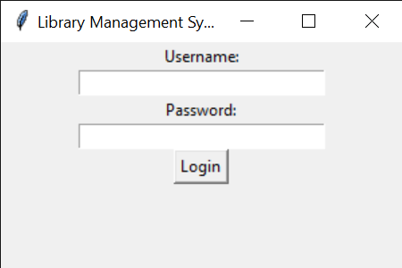
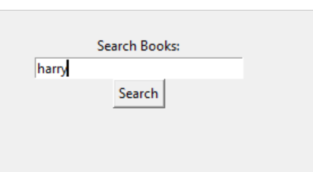
Operations
Login Window: Username, Password, Remember Me
Main Window: Buttons for each entity
Search Functionality: Search for a book by name

Slide 6
Conclusion
Successes: Implemented key features, login functionality, and search capability
Challenges: Implementing advanced features, ensuring data integrity
Future Enhancements: Adding more features like user management, advanced search, and analytics
Thank You!

